Slide 1

Notes:
This is a day I've been looking forward to for 15 years. Every once in a while a revolutionary conference badge comes along that changes everything. And BSides Canberra has been fortunate to deliver a few of these into the world.

Slide 2
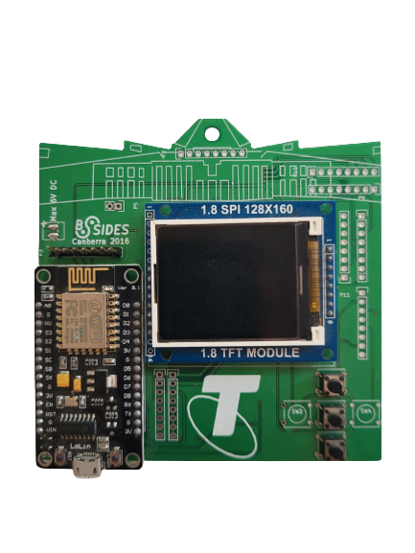
2016 & 2017
Notes:
In 2016, we introduced the Bsides Canberra electronic badge – with a color screen and ESP8266 process – we changed the game on what a conference badge could be. Supporting WiFi, we even had it displaying twitter feeds.

Slide 3
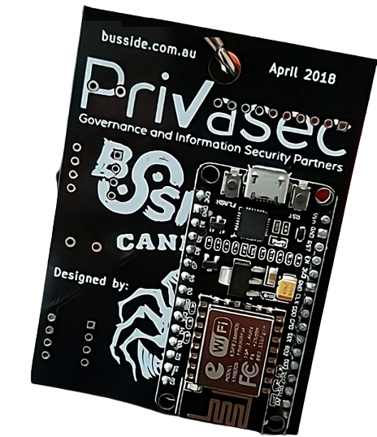
2018
Notes:
In 2018, we introduced the BusSide badge. And it didn’t just change the way we repurposed conference badges – it changed the entire purpose of a conference badge. Putting hardware hacking, chip reading, serial, I2C and SPI bus hacking into every attendee’s hands.

Slide 4
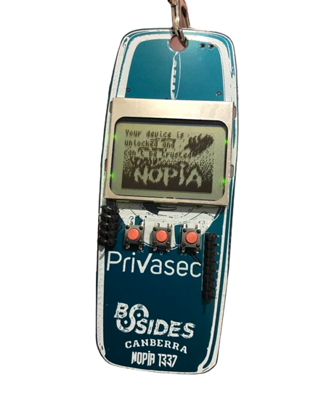
2019
Notes:
In 2019, we introduced the Nopia – playing into the hands of nostalgia, we showed how much you can do with limited hardware. And first made use of QR codes as means of interactivity.

Slide 5
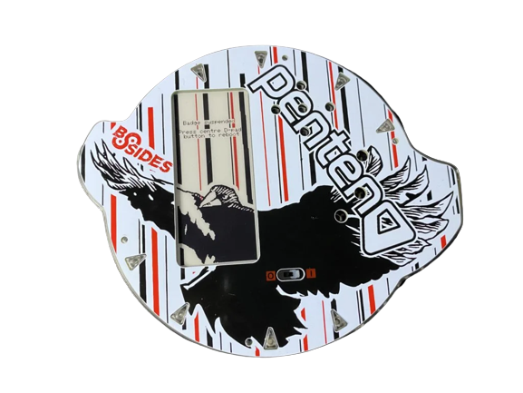
2021 2022
Notes:
In 2022, we introduced the most advanced electronic Badge the industry has ever seen. With e-ink display, tons of customization and built-in challenges – it pushed the limits of what a badge can be.

Slide 6
Notes:
Well today, we’re introducing 3 new revolutionary products of this class.
The first one…

Slide 7

Colour screen badge with touch controls
Notes:
Colour screen badge with touch controls.
The second is….

Slide 8

Revolutionary hardware learning device
Notes:
Revolutionary hardware learning device.
And the third…

Slide 9

Breakthrough hacking and CTF challenge
Notes:
Breakthrough hacking and CTF challenge.

Slide 10
Badge
Tool
CTF
Notes:
So, 3 things:
A colour screen badge with touch controls.
A revolutionary hardware learning device.
And a breakthrough hacking and CTF challenge.

Slide 11
Notes:
A badge

Slide 12
Notes:
A hacking tool

Slide 13
Notes:
A CTF

Slide 14
Notes:
A badge

Slide 15
Notes:
A hacking tool

Slide 16
Notes:
A CTF.
Are you getting it? These are not 3 separate pieces of conference swag.
This is one Badge. And we are calling it…

Slide 17
bPod
BSides reinvents the badge
Notes:
bPod
Today, Bsides Canberra is going to reinvent the conference badge.

Slide 18
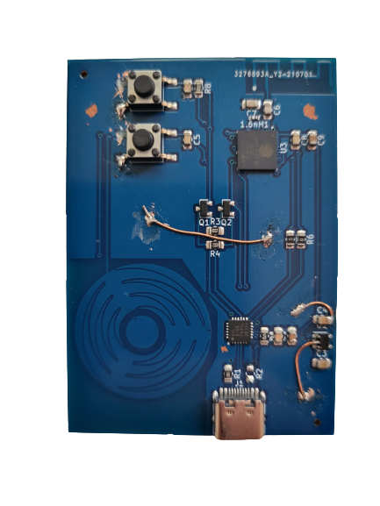
Notes:
And here it is.
This was the first prototype I did.

Slide 19
Smart Badges
LEDs + microcontroller + Challenges
Notes:
So before I get into it let me talk about a category of things called Smart Badges.
And they typically combine some LEDS (maybe a screen) plus an embedded microcontroller plus some CTF challenges.

Slide 20
Smart Badges
Utilities
Notes:
And they might have some utilities on them, maybe listing WiFi networks.
And the problem is that they are not so smart and not so easy to use.

Slide 21
advanced
bPod
smart
badge
hard
to
hack
smart
badge
easy
to
hack
smart
badge
conference
badges
simple
Notes:
So if you kindof make a business school 101 graph of the hack axis and the easy to use axis.
Regular conference badges are there, and you know they have some blinking lights but usually not easy to use – you can’t just easily plug them into a computer and reflash them for other uses.
Now smart badges are definitely a little smarter but they are actually harder to use. They tend to have complex controls or require very specialised flashing and reprograming tools/techniques. Just for the basic stuff, like changing an LED or displaying a picture – people have a hard time getting started customizing their own hardware.
Well we don’t want do either of these things. What we want to do is make a leapfrog badge that has way more advanced built-in features and super easy to hack and modify for your own projects.
This is what bPod is.

Slide 22
bPod
Notes:
So lets take a look a what makes the bPod special.

Slide 23
Revolutionary UI
Years of testing on hackers
Notes:
Revolutionary user interface
Which is the result of years of developing and evolving badges for the conference.
And offcourse its an interplay of hardware and software.
Now, why do we need a revolutionary user interface?

Slide 24
2016
2018
2019
2021
Notes:
I mean, here are 4 BSides conference Badges.
We have the first 2016 badge, the BUSSides, Nopia and so on.
And what’s wrong with their user interface? Well the problem with them is in the input and output.

Slide 25

Single point of failure
2016
2018
2019
2021
Notes:
Its this stuff right here.
We have had tremendous difficulty in creating user output.
In 2017, half the screens and a different display driver.
In 2018, we had no screen – which meant you had to be at your computer to make use of it.
In 2019, we had to manually fix 100s of screens because the manufacture didn’t properly align the pads to the display.
In 2021, we went all in on E-ink which added significantly to the cost of production.
And it’s the same story with input. These badges have limited GPIO pins we can use for buttons.
In 2016, we were not able to use 2 of the expected pins for buttons and hence they were not placed.
Even this year, we had an LED that won’t work because of the processer has a poorly documented “feature” that pin 46 cannot be used for output.
And then we get into chip shortage and surging prices for parts – how do we combat these issues for a small conference?
It’s a single point of failure. So how can we solve this?

Slide 26



Redundancy
Notes:
Its called redundancy.
Why don’t we take the built-in input/outputs of a badge such as buttons and screen. And keep the serial and terminal support.

Slide 27
Notes:
So how we going to take this to a electronic badge?

Slide 28
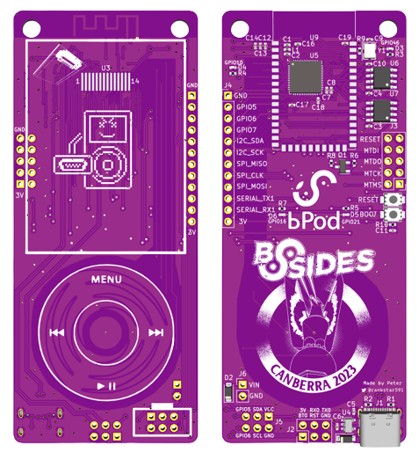
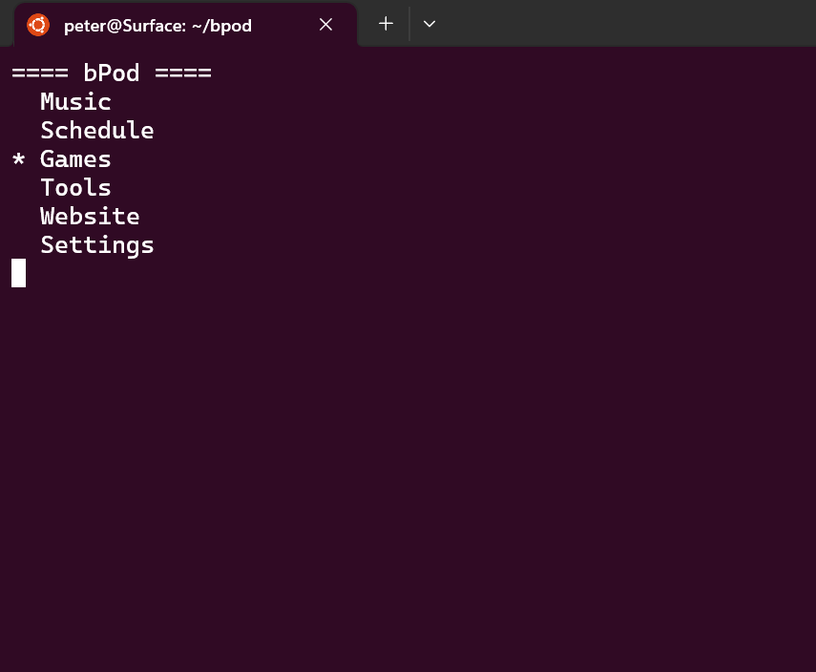

Notes:
And just have a touch wheel and screen.
With the entire UI replicated on the serial port – right down to the last sprits in the included games.
So how do you communicate with this badge? Well you can just use the wheel and screen, or you can use your computer keyboard – or you can scroll the terminal using the wheel.
It works just like magic.
And we have safe-guard ourselves against not having working hardware.

Slide 29
Design
On a budget

Slide 30
2 Layer PCB
1 side assembly
Standard track/vias
Small / simple shape
Dual microcontroller footprints
Notes:
Small simple shape to keep manufacture costs down in regards to paneling.
These were designed in kicad.

Slide 31
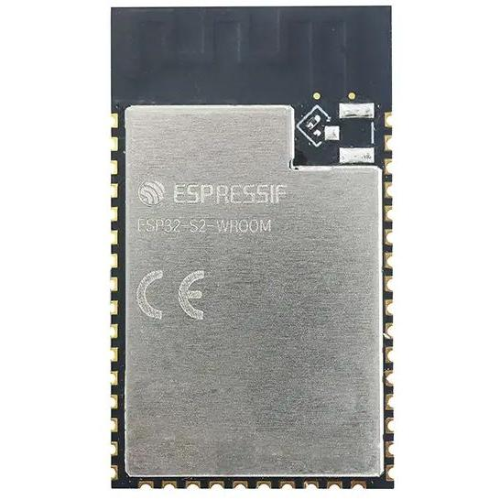
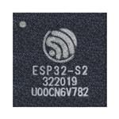
Dual footprints
ESP32-S2
ESP32-S2R2
ESP32-S2FH2
ESP32-S2FH4
ESP32-S2FH4R2
ESP32-S2-WROOM
ESP32-S2-WROOM-I
ESP32-S2-WROOM-N4
Notes:
We even have redundancy in the types of microcontrollers we can use.
Not just in terms of which ones have builtin flash and RAM, but also in terms of package sizes.
Whats in stock can change rapidly, and if you have bet on a particalur chip – you can be left with long leads times, or the need to re-design your PCB…if it hasn’t already been made yet.
ESP32-S2 was highly affordable on its own.
4MB flash is popular and in-demand for embedded devices.
Was easier to source 2MB flash chips.
You can desolider and upgrade your flash chips.
TODO
Which chip is going to be available without a lead time in 6 months?
How can we mitigate this risk?
Dual footprints – so we can drop any ESP32s2 (or even ESP32s3).
Even a CAN package.

Slide 32
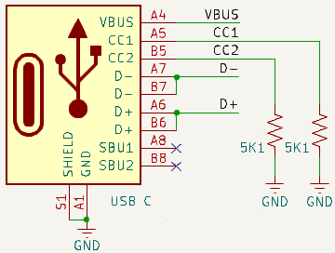


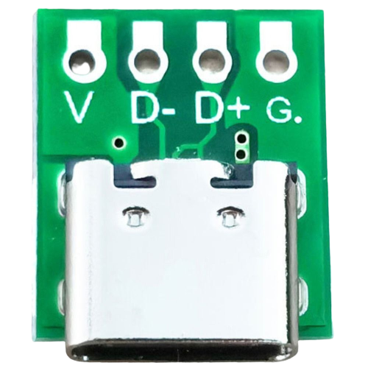

USB-C
Notes:
Using a USB-C cable with the bPod enables you to power and control your devices with one cable.
Everyone has USB-C cables and chargers now – they are so common.
Look at latest WDC event and take notes from there:D
Our first badge with USB-C
Built in USB controller – no need for USB-to-serial chip

Slide 33
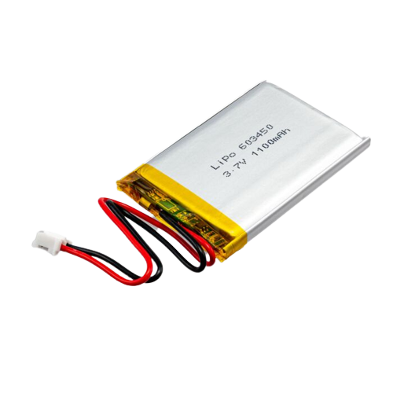
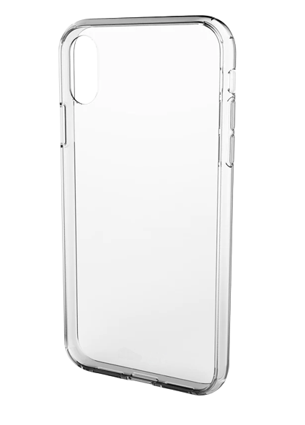
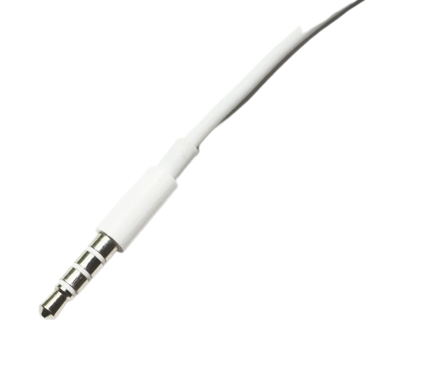
Courage.
Notes:
We didn’t just remove the headphone jack, we removed the battery and case as well
To reduce e-waste, we removed the battery.
Using the battery that everyone has – your phone.
Using the charger that everyone has -

Slide 34
Hardware
Drawing to prototype

Slide 35
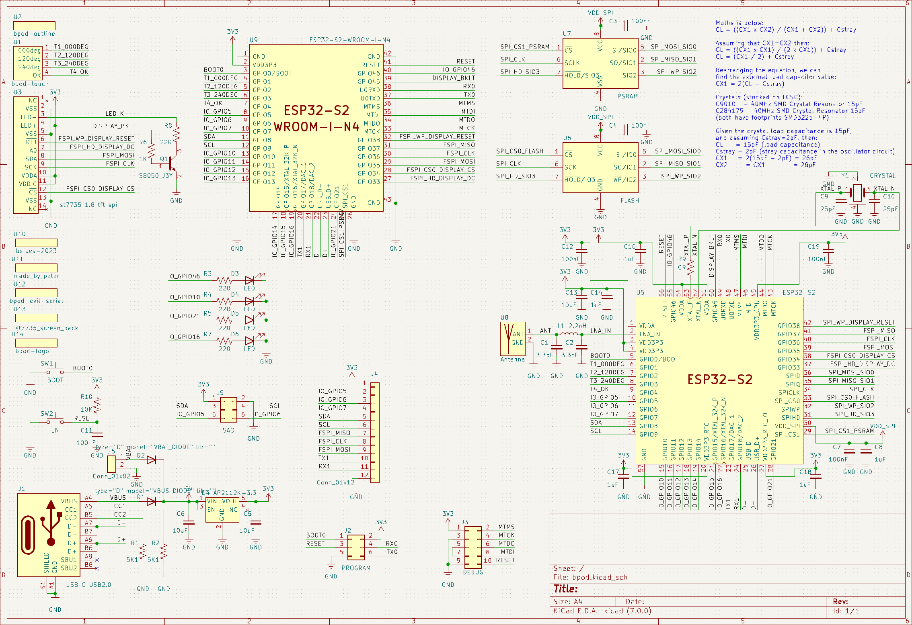

Slide 36
USB power and data

Slide 37
5V to 3.3V
Notes:
USB 1, 2 and USB C by default delivers 5V – most microcontrollers will run on 3.3V. Your phones actually run on 1.8V.
So, in order to be able to not release the black smoke from our chips, we have a voltage regulator that does the conversion to 3.3V for us.

Slide 38
VIN – External power / battery
Notes:
The VIN header on the badge can be used to hook up 3 x AAA batteries to power your badge. You can even re-purpose a battery pack from previous years badges, or get one from your local Jaycar. But, given there are 3000 of you hear today – maybe don’t all go visit the 1 Jaycar in Canberra all at once ….

Slide 39
RESET and BOOT buttons
Notes:
We provide these buttons so its easy for you to re-program and repurpose your badges for your own projects.
On more professional devices, these wont necessarily be added. But you can lookup chips, find schematics, and add the buttons yourself.

Slide 40
Pretty LEDs
Notes:
GPIO46 on the ESP32s2 cannot be used as an output.
This is not clearly documented – and is (apparently) quite common to find these quirks in hardware. I was luck this wasn’t something important like the screen backlight control.

Slide 41
4 x Capacitive Touch == Wheel
Notes:
We actually implemented auto-calibration – so by rotating your finger shortly after power on, it figures out the ranges of capacitive values and then calculates the most likely position on the wheel.
Hardware and software is a ratio – what you do simple in one requires a lot of effort on the other. In this case, 4 touch pin saves GPIOs, but requires more software to make it work.

Slide 42
LCD screen
Notes:
This is the same screen used on the 2016 and 2017 badges. It was chosen to reduce risk as we have worked with it before.

Slide 43
Backlight / brightness control
Notes:
This circuit stops a large amount of current being drawn from the ESP32s2 microcontroller – which might damage it.
Basically, the current that can be drawn by the screen is a ration of a small amount of current output by the ESP32s2.
By setting the pin to an Analogue value, we can control the brightness (instead of using a digital value).

Slide 44
Expansion headers
SAO
Utility
Program
JTAG
Notes:
SAO – Shitty Add On
Utility header – for use with the tools on the bPod – and for custom / external hardware you might like to add.
Program header – for flashing ESP32s2 over serial. However, you can flash the ESP32s2 directly over USB so its not really needed.
JTAG – For debugging the ESP32s2. It should be noted that JTAG is not required for any challenges you might find on the badge.
It should be noted that the only standard for JTAG is that there IS NO STANDARD.

Slide 45
External RAM
External Flash
Notes:
The ESP32s2 has a small amount of internal RAM and so we didn’t provide external RAM to keep the costs down.
However, the ESP32s2 chip we chose ALSO didn’t have an Flash – hence you will see a 2MB flash chip on your badge.
For those IoT keen/wannabe hackers out there – there is no security on this. Just like all those random gadgets in your house….

Slide 46
40MHz crystal
Notes:
These ESP32 chips require an external oscillator. And none of the datasheets for the ESP32 will tell you which capacitors to use.
You need to use a formular using values from the manufactor to calculate the capacitors to use to get the 40Mhz you desire.
I want to give a huge shout out to my mate Joshua Johnson for helping me out on this.

Slide 47
ESP32s2
(CAM)
ESP32s2
(IC)
Notes:
CAM packages are more expensive than getting the individual parts, but also come with RAM, FLASH, WiFi antenna and 40MHz crystal.
Purchasing a CAM is lower risk, but we needed to keep costs down so we sourced individual parts.
How did we know how to wire it up? You go online and you steal other peoples schematics. In fact, I looked at the datasheet for one of these CAM packages (which had the RAM, flash, crystal) and used its schematic to help we design the IC part of the schematic. Remember – you don’t need to know everything, just where to look.
I leant heavily on previous year’s badge’s schematics too to help me figure out which wire needs to go where.
And if you want to make a start designing your own PCBs, steal from Bsides badge designs!

Slide 49
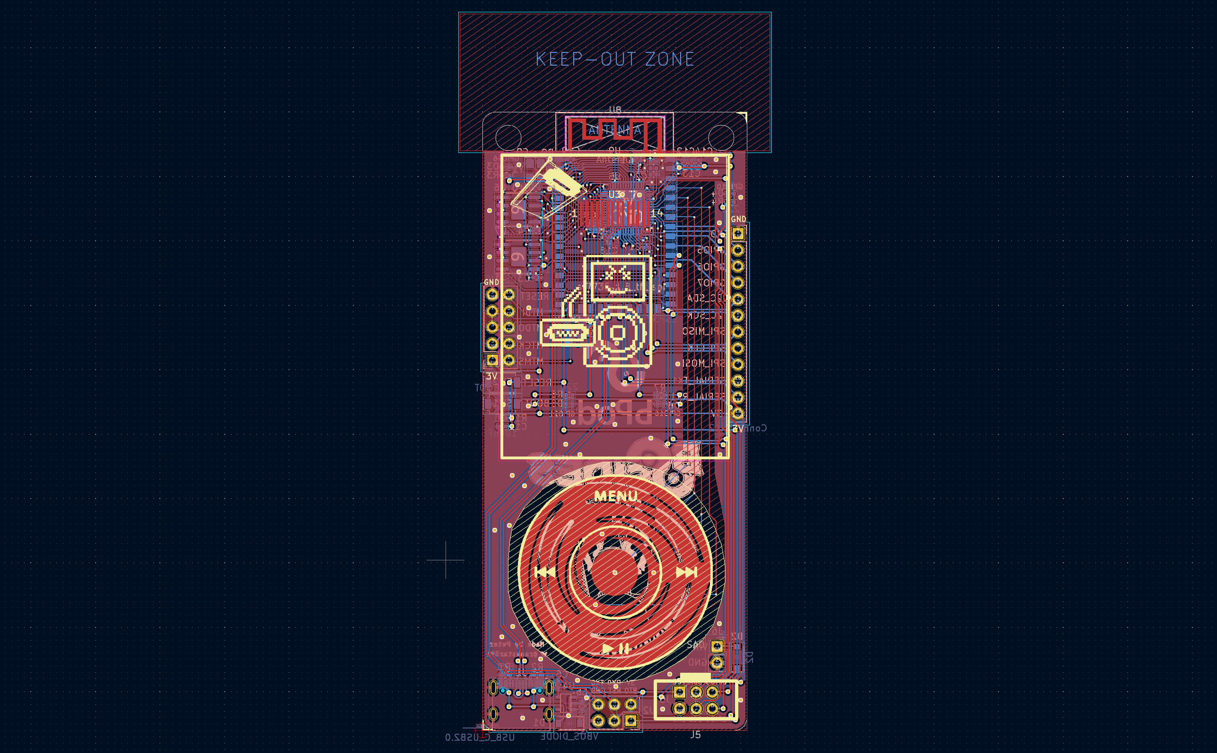
Notes:
Lots of re-iteration and design.
Vertical and horizontal lines.
Come see us in the hardware hacking village to learn more about your own PCB design.

Slide 50

Right to repair
Notes:
Schematics, PCB design, source code will all be available after the conference.
Don’t want to make it too easy for you hackers

Slide 51
Software
Hardware to hacker engagement
Notes:
Software tooling choices such as editor, compiler, frameworks, programing languages

Slide 52


Notes:
You bPod comes with WiFi – so why aren’t we using it?
What happens when you unlesh a bunch of hackers onto a WiFi network with 3000 embedded devices??
Use the internet connection you all have – your phones.
And after the last few years, I’m pretty sure we ALL know how to scan QR codes with our phones.
But nothing stops you from follow online examples and using the WiFi on your bPod – its fully functional.

Slide 53
USB to serial
i2c detect
i2c sniffing
SPI sniffing
GPIO expander
Notes:
Not just a few utils
Limited version of tools.
This is a full USB-C to serial device.
(Use the format of not just a limited web browser)

Slide 54
Snake
Tetris
Cybears CTF
Notes:
Not just a few utils
Limited version of tools.
This is a full USB-C to serial device.
(Use the format of not just a limited web browser)

Slide 55

Your device has
been unlocked and
can’t be trusted
Your device is now hackable
Notes:
Unlocked bootloader
We don’t lock bootloaders and make a CTF challenge with it
You are free to build and upload any software you like

Slide 56

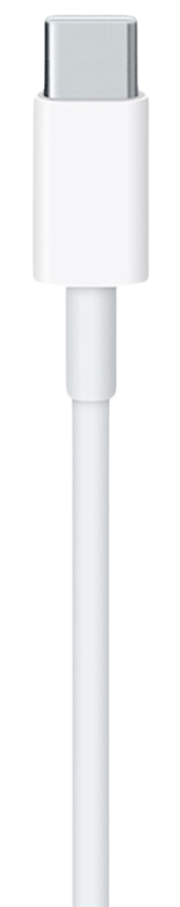
bpod.bsidescbr.com.au/update.html
Notes:
Download the bPodUpdater from the website
QR code to link availbe on your bPod
Get the latest schedule and features

Slide 57
Production
From a few to a thousand

Slide 58
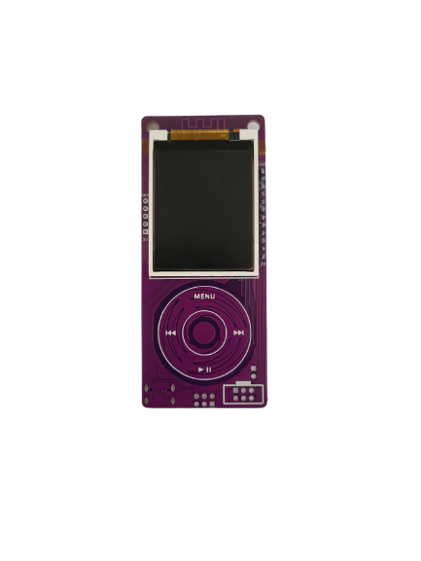
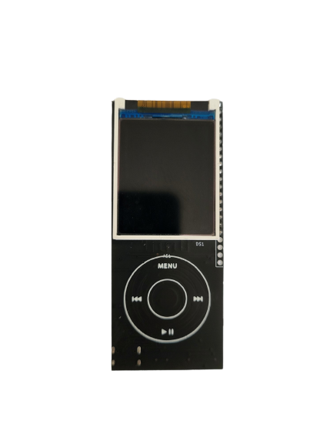
Prototypes
Notes:
We tend to iterate through a few prototype runs.
The first one you see is just dumping a bunch of parts on a board and figuring out how “not” to wire things up.
The second was more functional, but still had a lot of mistakes. It was also had an expensive BOM due to poorly selected parts and design choices. Also note its lack of headers.
Then we have the prototype which is almost identical to the ones you have – I had mislabled a few components, but was otherwise functional.
When we are feeling more confident, we make an order of say 40 badges and check that they come back functional from the manufacture such as PCBway.

Slide 59



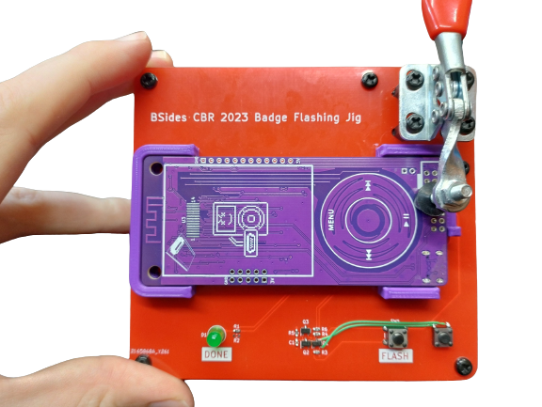





Ordering
Gerb and Drill files
Bill of Materials
Pick and place
Firmware image
.ZIP
.XLS
.POS
.BIN
Notes:
Sights like PCBWay where you can order boards have instructions about how to export these files from KiCad.
Planning for the PCB manufacter to program and test.
Ended up submitting a 2MB flash file – pre-flashed before solidering
Very stressful – once chance to get it right.
Huge shout out again to Joshua Johnson who is in the hardware hacking village – he designed and built this Jig.
Even now I wish I had exposed the USB pins on a header so we didn’t need to plug and unplug the USB cable in the Jig – lessons for next time.

Slide 60



Shipping
Notes:
Lead times for parts can be a real concern – we do our best to have redundant parts options.
Customs – which have caused us delays as well as unexpected costs to the conference.
Fixing defects on the boards – maybe we could go back to the manufacture, but we have a small time window before the conference.
And if that all goes to plan, you get a bPod.

Slide 61




Peter Rankin
rankstar59@gmail.com
@rankstar591
gitlab.com/pjranki

